Slide 1

Status of SCAO system at mid-FDR
Sauvage J.-F., Schwartz N., Correia C., Petit C., Dohlen D., El Hadi K., Vola P., Renault E., LeMerrer J., Morris T.
Vernet J., Paufique J., Holzlohner R., Clarke F., Schnettler H., Bryson I., Thatte N., Neichel N., Fusco T.
And all HARMONI consortium

Slide 2
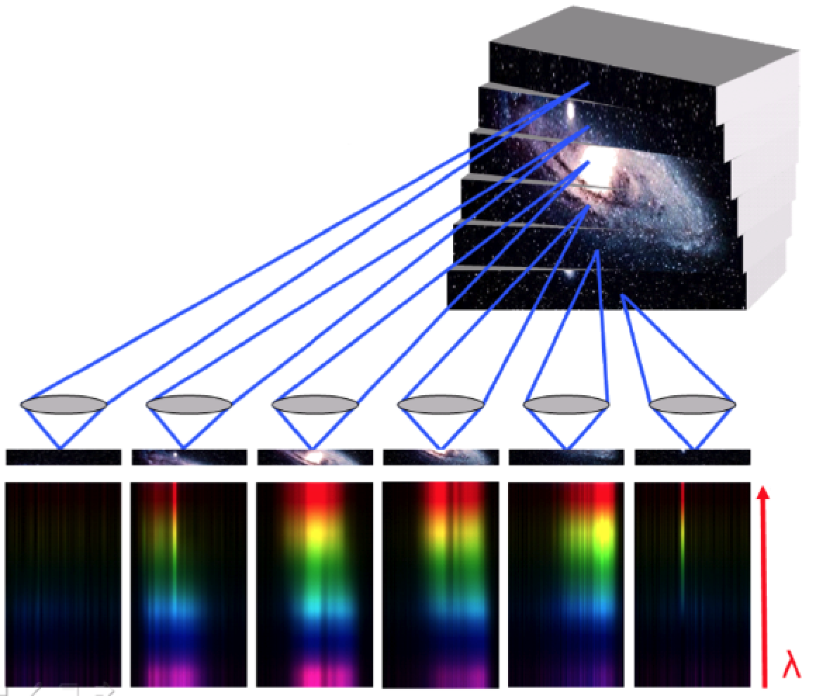
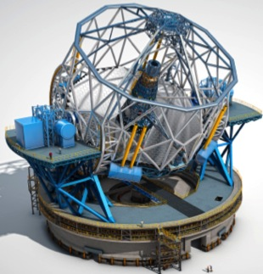
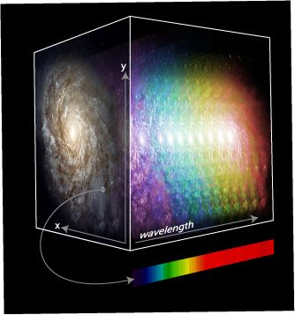
HARMONI Overview
Workhorse instrument - visible and near-infrared spectroscopy (0.45–2.45 µm)
Integral Field Spectrograph – providing ~ 30 000 spectra per exposure
3D data cube
ELT 1st light
Dec 2017
Feb 2020
PDR
FDR
MAIT
Install/Commissioning
Today
2025

Slide 3
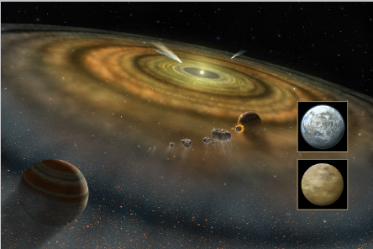
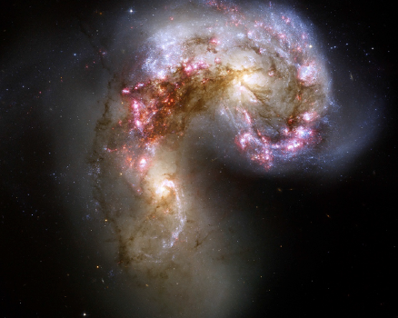
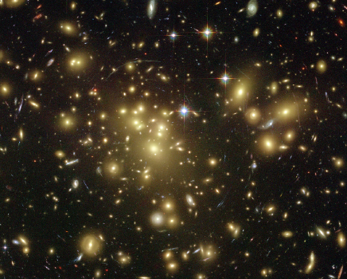
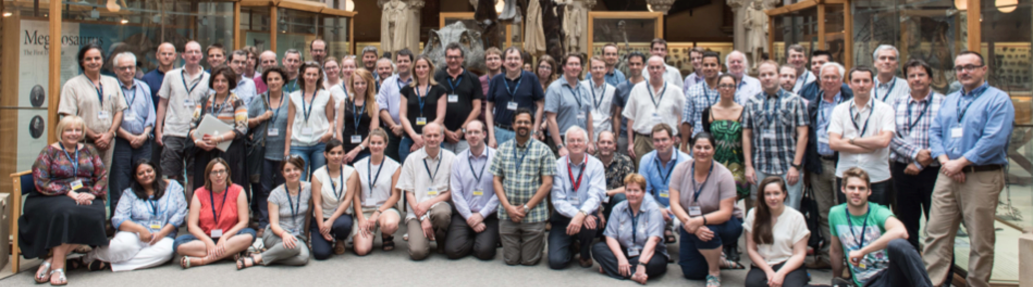
HARMONI – Science Cases
Planet and Stars
Galaxies and cosmology
Stars and galaxies

Slide 4
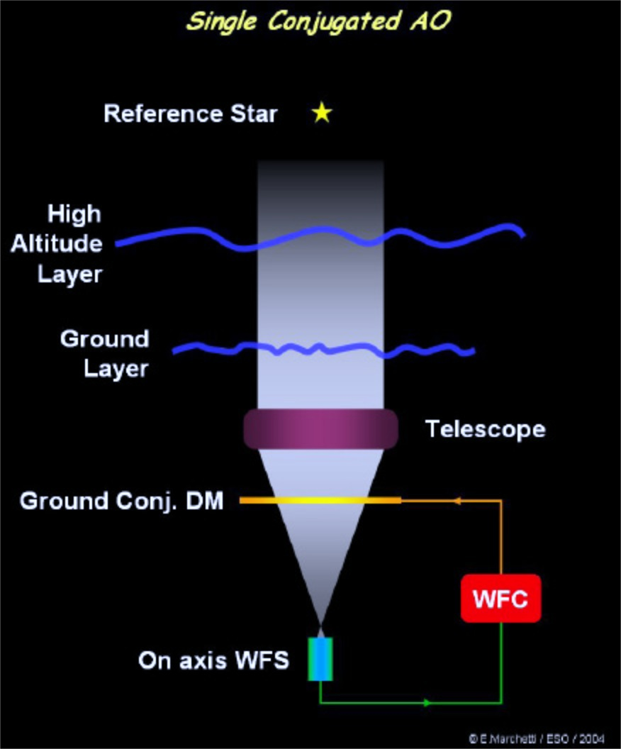
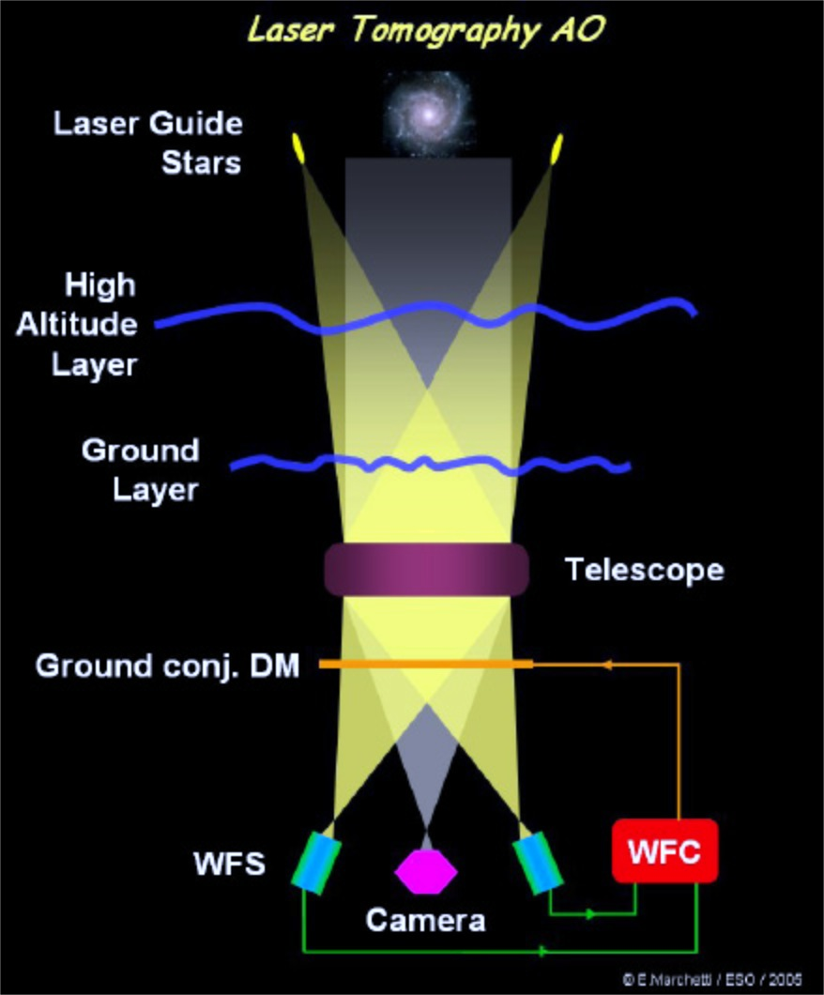
HARMONI Overview
High-Performance
High Sky coverage
Best-Performance – Low sky coverage

Slide 5
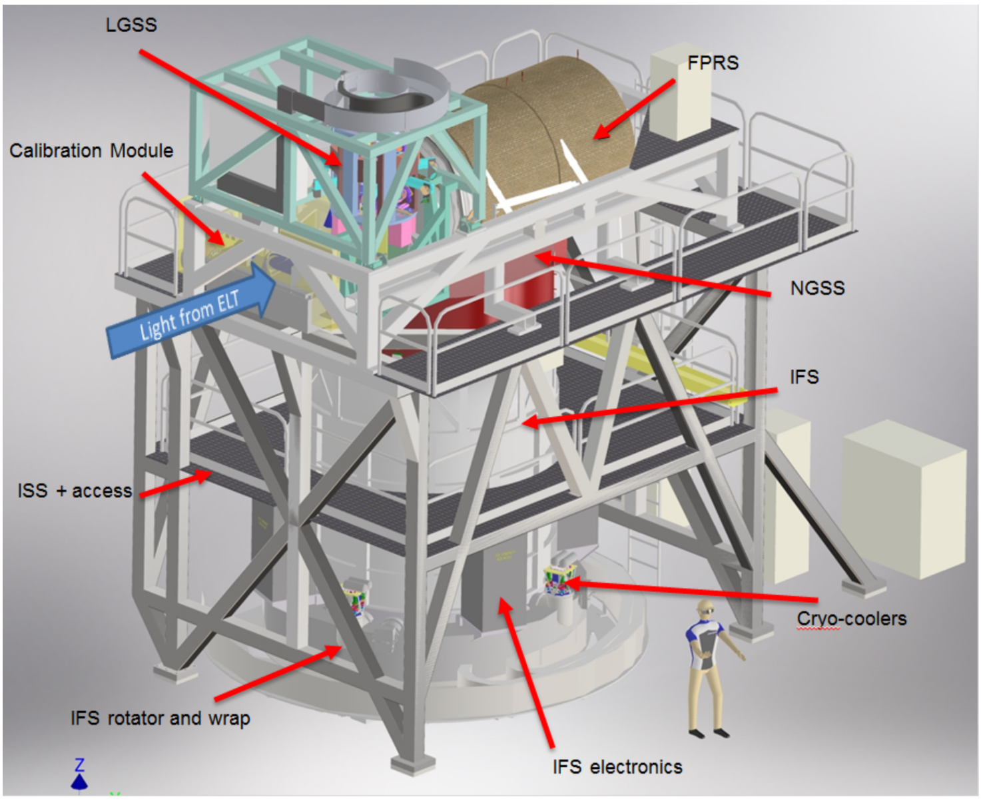
The HARMONI instrument
Natural Guide Star System
  SCAO
  HCM

Slide 6
HARMONI SCAO Requirements
High performance, low sky coverage
  > 70 % SR in K band
  < 100 nm residual error of WFS
  Magnitude 12 star
Largest wavelength 800nm
Able to close on NGS 15 arcsec away from science
Able to close on large extended object up to 3’’

Slide 7
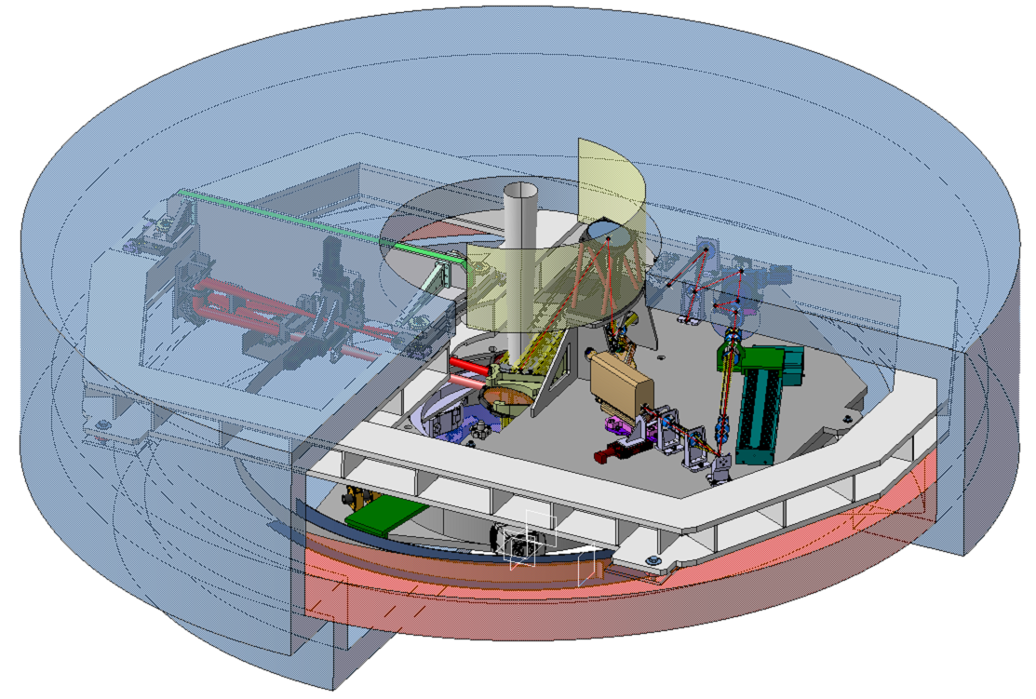
SCAO in NGSS sub-system

Slide 8
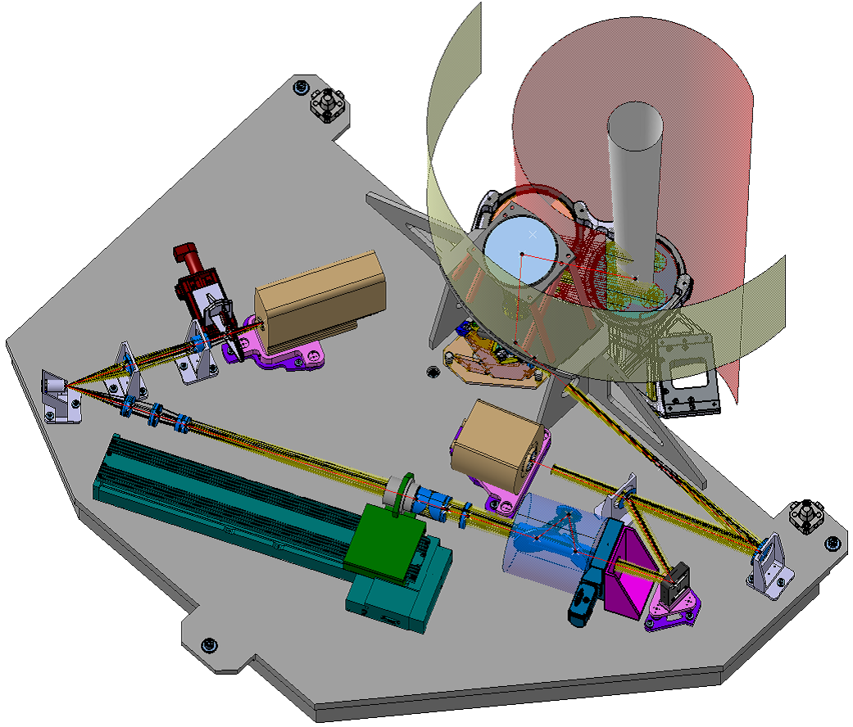
SCAO Design / functionnalities
High Order WFS
  Pyramid, modulated
  700-800nm
  700-1000nm
Dichroic selector
  800nm
  1000nm
Object selection mirror
  15 arcsec radius
Pupil loop
  Shift
  Distorsion
Low Order Loop
  Differential tip-tilt
  NCPA
  LODM 9x9
  LOSH 8x8 650nm
Linear ADC

Slide 9
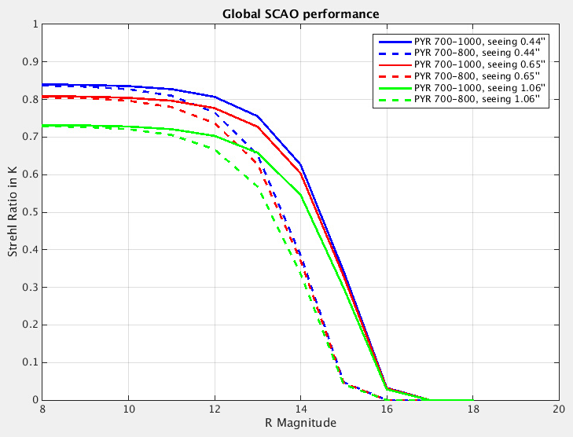
Global SCAO Performances
Includes
  Turbulence, ESO-median profile
  Magnitude 12 star
  30° Zenith angle
  M4 geometry and actuators positions
  SCAO / Instrument terms
    Island residuals
    NCPA residuals
  Telescope contribution
    Static contribution
    Dynamic contribution (exc. LWE / vibrations)
Strehl Ratio @ K band > 70%
  Very small margin

Slide 10
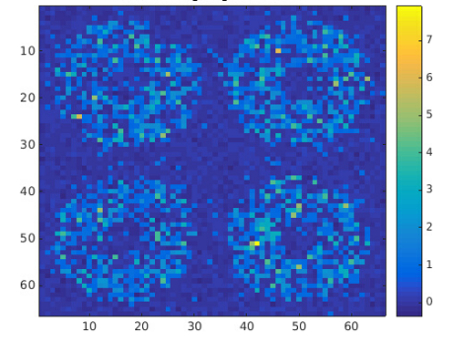
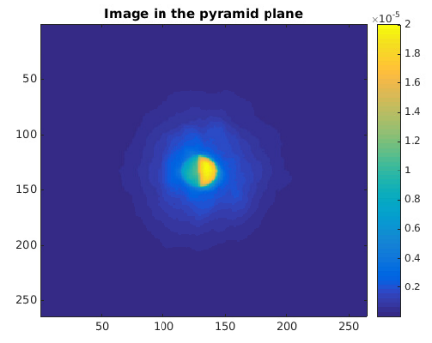
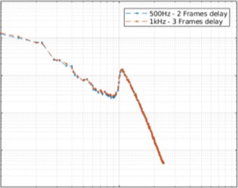
Updates since PDR
Extended object
Optical gain
Islands
Pyramid specifications
Main loop Framerate
Performance for high-contrast
LWE
  Study ongoing by ESO, R. Holzlöhner
N. Schwartz poster, this evening
DSP Amplitude [a.u.]
Spatial Frequency
Residual PSD
V. Chambouleyron talk, monday
A. Carlotti poster, monday

Slide 11
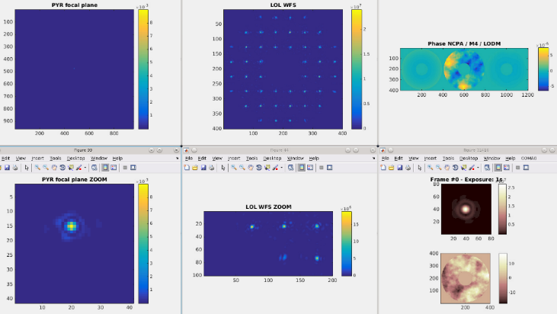
SCAO – Low order Loop simulation
PSF on Pyramid
Blue Shack
Closed loops PYR + LOL
NCPA absorbed by LODM
Flatten WF on PYR / BlueShack / Science
CONCLUSIONS :
PRINCIPLE VALIDATED
PERFORMANCE ANALYSIS ONGOING

Slide 12
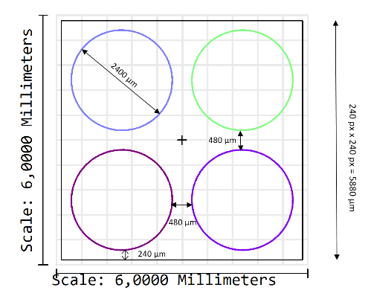
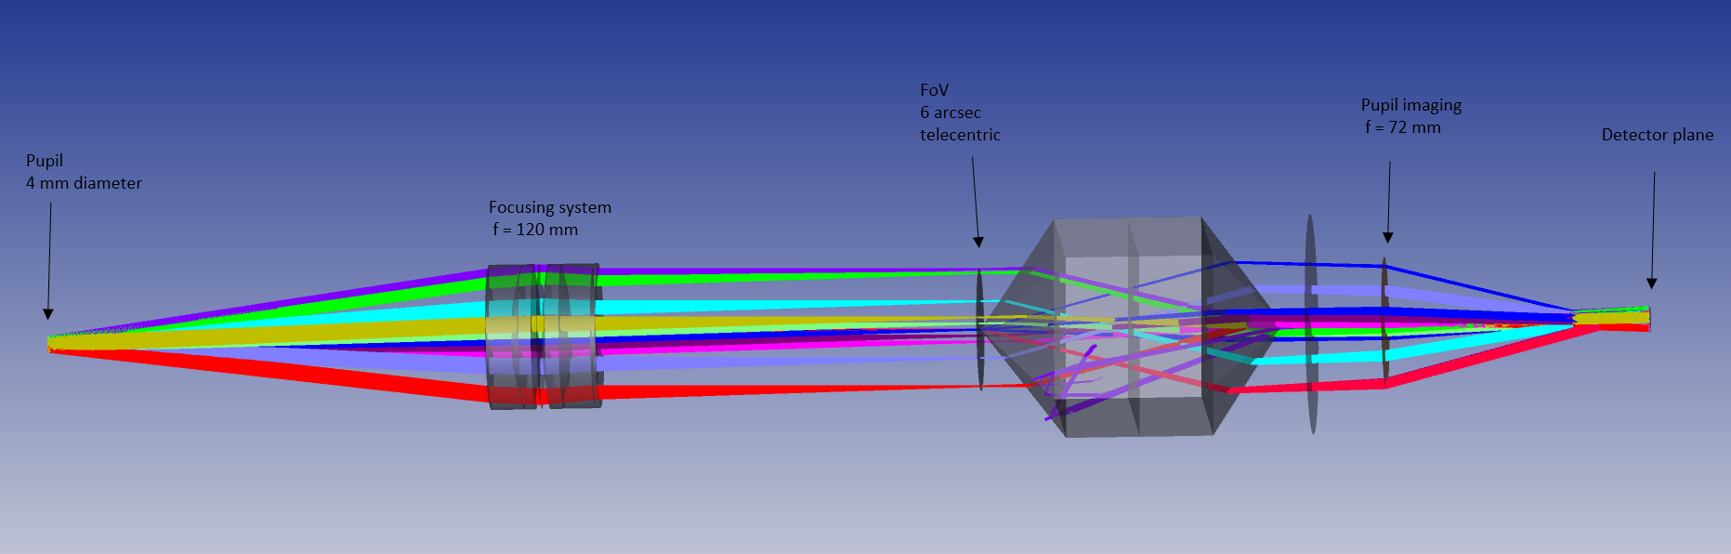
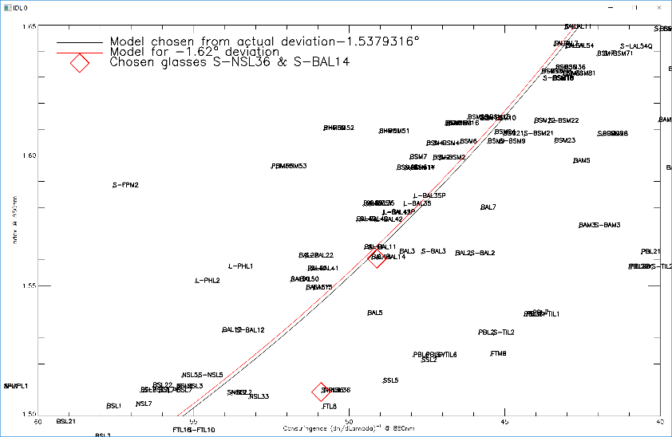
Pyramid prism optical design
Followed the TMT approach
  Release constraint on the pupil imaging absolute precision
  Calibration of interaction matrix compensates for position errors
Geometrical model of double pyramid
  Deviation / index / dispersions
Challenge
  Low chromatism
  Large Field of View
Final design
  The 1st lenses group makes a telecentric image onto the pyramide
  1st pyramide placed in field provides 4 beams. The 2nd corrects the chromatism (<0,1µm in the pupil plane). The pyramides are glued then the glasses have the same CTE (S-BAL14 / S-NSL36)
  the 2nd group (today paraxial) gives the good magnification to the pupils
CONCLUSIONS : SOLUTION FOUND – SEARCHING FOR INDUS

Slide 13
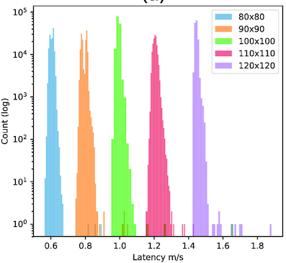
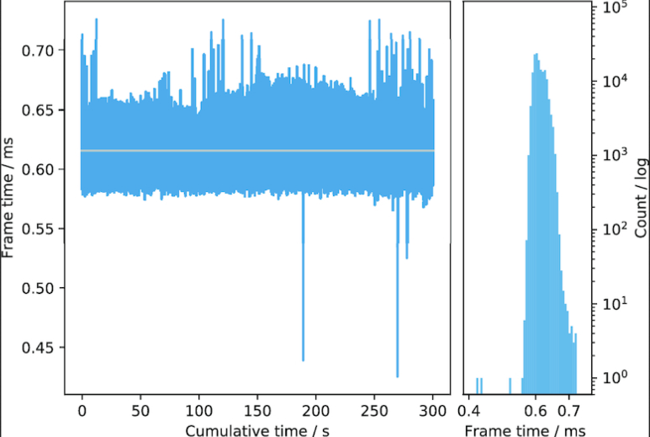
HARMONI SCAO RTC - Durham
SCAO uses only a single AMD EPYC or Xeon Phi CPU
  5318 controlled modes
  500Hz operation
Plot of measured latency versus pixels per Pyramid pupil for Xeon Phi
Only have 80x80 SH SCAO on EPYC
  Next generation EPYC will reduce latency further
Multi-node SCAO implementation possible but may impact latency further
Poster by S. Dimoudi
Poster by E. Younger
Poster by D. Jenkins
Talk by M. Townson
CONCLUSIONS :
WE HAVE AN RTC SOLUTION –
PEOPLE WORKING ON IT
Jenkins et al., MNRAS 2019, https://doi.org/10.1093/mnras/stz638

Slide 14
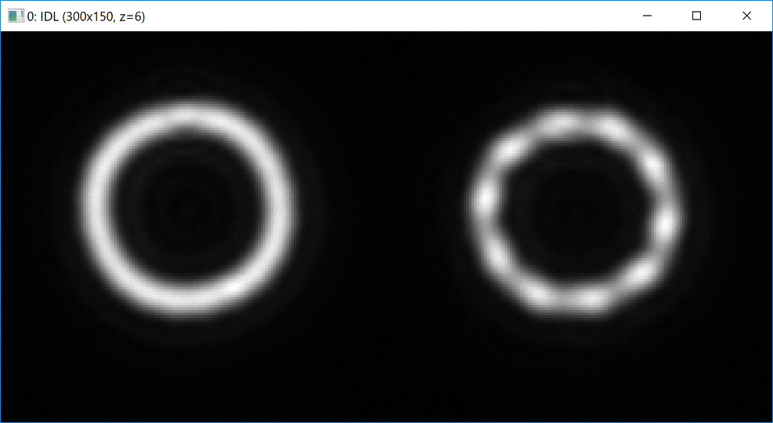
Prototyping activities : OSM / PMU
Main specs validated for OSM and PMU at ambiant temperature
K. El Hadi poster this evening

Slide 15
AIV strategy
NOT capable of demonstrating the ultimate performance of SCAO (M4/M5 not available for AIT)
Validate the performance in two regimes
  Fast Low order
    Atmospheric jitter
    Windshake
    Vibration
    Low Order Optimisation
  Slow High order
    Fitting error
    Ultimate performance, NCPA
    Mis-registration estimation
    Interaction matrix calibration
Development of dedicated AIT tools

Slide 16
Conclusions
SCAO on the path to FDR
SCAO analysis almost complete
  Pathologic cases (binary stars…)
Global mechanical / optical design
RTC solution identified
Critical components prototyped at ambiant temperature

Slide 17
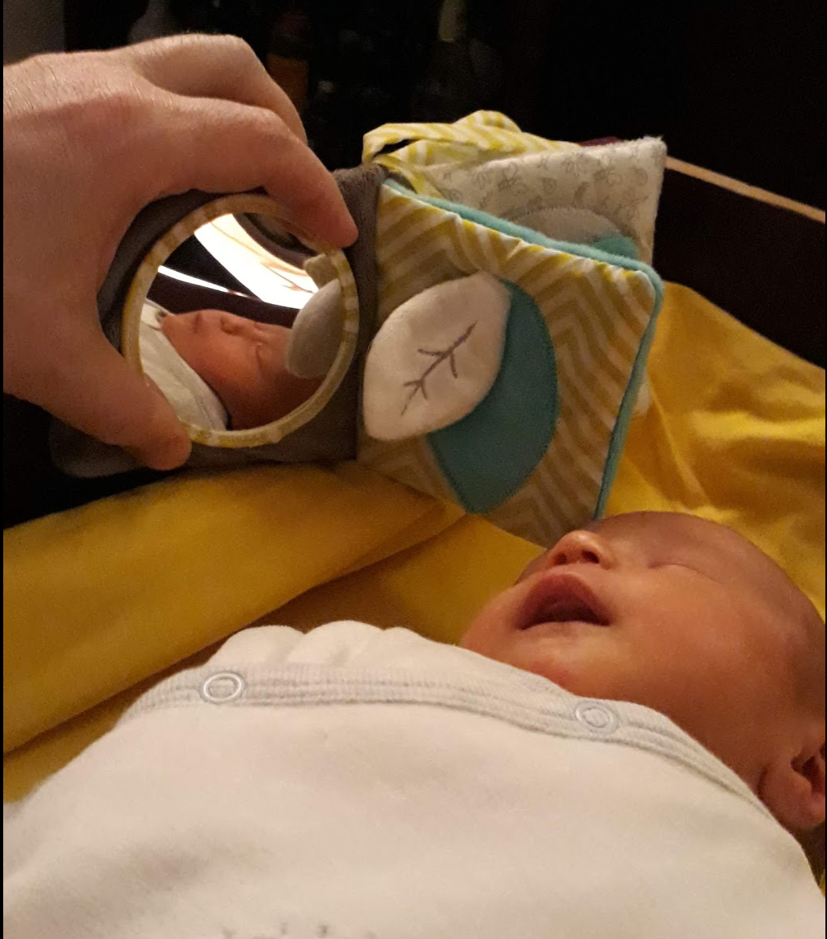
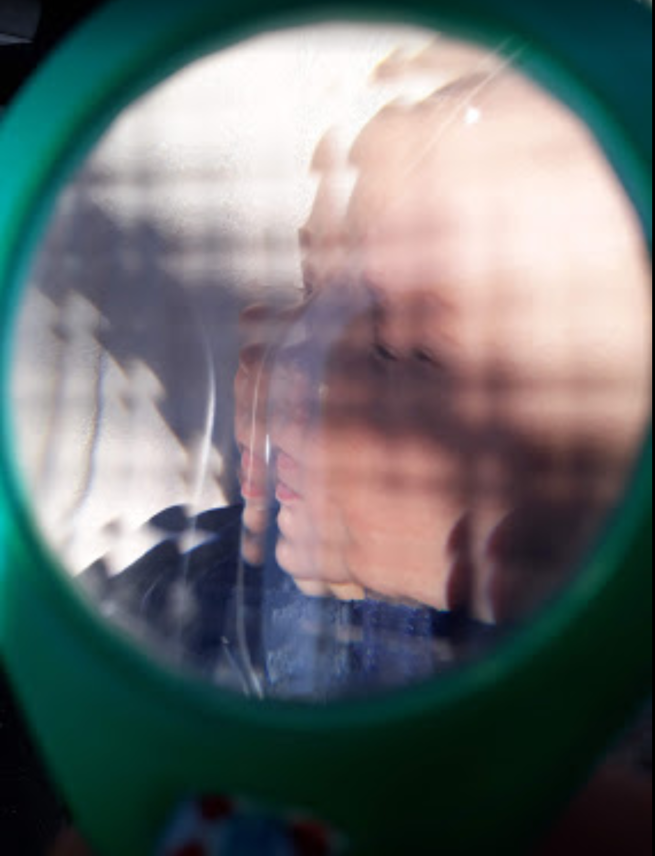
New member in the AO team

Slide 18
SCAO – NCPA strategy
NCPA error budget
  Differential tip-tilt between SCAO and Science
  Usual NCPA
2 cases to considere
  SCAO => compensate low orders of NCPA
  SCAO-HCM => compensate low and mid orders of NCPA
Low orders
LO
Mid orders
MO
High orders
HO
1/(2pitch_{LOL})
4 cyc/pup
1/(2pitch_{M4})
37 cyc/pup

Slide 19
M₄
NCPA scheme – SCAO alone mode
(1)
(2)
SBS
(1) – Closed loop pyramid / M₄
NCPA_{SPYR} seen by PYR
NCPA_{SPYR} introduced on M4
(2) – Compensation of low orders by closed LOL
(3) – NCPA measurement from IFS
NCPA_{SCIENCE} measured on IFS
NCPA_{SCIENCE} (low orders only) projected onto SBS reference slopes
(3)
{NCPA_{SBS}}
SPYR
{NCPA_{SPYR}}
LODM
{NCPA_{SCIENCE}}
IFS

Slide 20
M₄
NCPA scheme – SCAO + HCM mode
(1)
(3)
SBS
(2 Low orders)
(1) – Closed loop pyramid / M₄
NCPA_{SPYR} seen by PYR
NCPA_{SPYR} introduced on M4
(2) – NCPA measurement from ZELDA
NCPA_{ZELDA} measured on ZELDA
NCPA_{ZELDA} (low orders) projected onto SBS reference slopes
NCPA_{ZELDA} (high orders) projected onto SPYR reference slopes
(3) – Compensation of low orders by closed LOL
(4) – Compensation of Science NCPA
{NCPA_{SBS}}
SPYR
{NCPA_{SPYR}}
LODM
(2 Mid orders)
{NCPA_{ZELDA}}
ZELDA
{NCPA_{SCIENCE_UP}}
FPM
{NCPA_{SCIENCE_DOWN}}
(4)
IFS
CONCLUSIONS : SCHEME VALIDATED / SIMULATIONS ONGOING

Slide 21
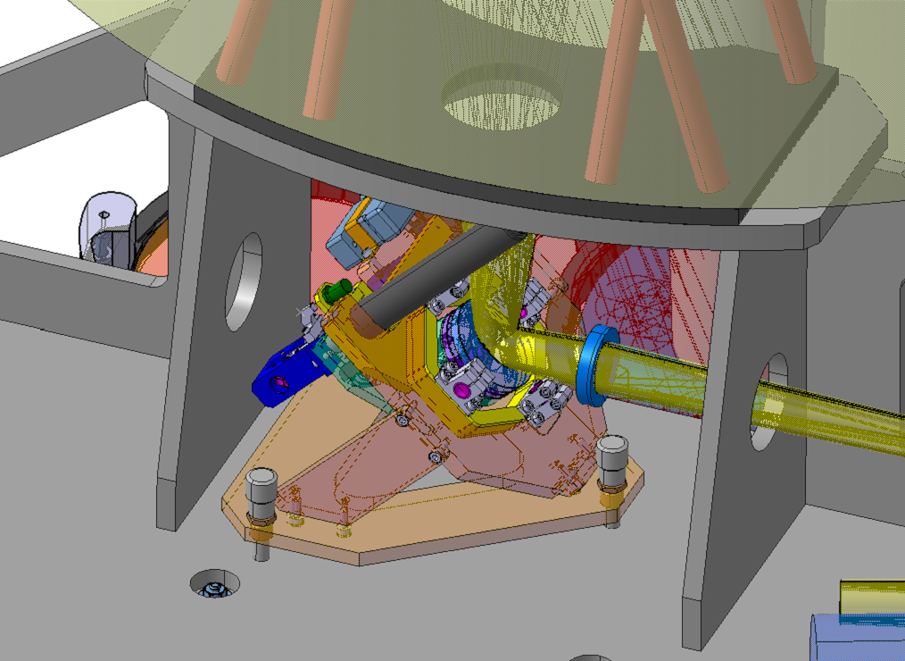
SCAO mechanical design
Object Selection Mirror
CONCLUSIONS :
Global design finalized
Detailed design ongoing (interaction with optics design)
Interface with NGSS finalized

Slide 22
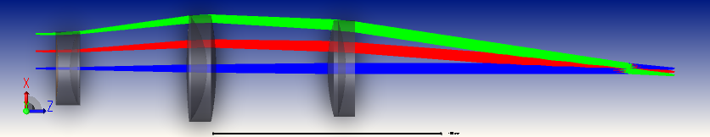
Pupil Zoom
Pupil
The pupil zoom can modify the size of the pupil to maintain it to 4 mm diametre within 0,1% error.
The pupil is projected onto the modulator
The lenses have a linear motion and the centre one can move on two other axis in order to stabilize the pupil
Its focale length is 100 mm ± 10%
CONCLUSIONS : SENSITIVITY TO CHROMATISM – E2E CHECK

Slide 23
BS
SOU
ATM
TEL
M4
DIC
OSM
LODM1
K Mirror
RTC
AIT-Software control box
ADC
PUP
PMU
PYR
Numerical link, HSCAO-AIT
Numerical link, HSCAO
HSCAO, complete set-up for performance estimation
Optical link
AIT Tools
SCAO final component

Slide 24
