Slide 1

A story of errors and bias
The optimisation of the LGS WFS for HARMONI
T Fusco, B Neichel, C Correia, L Blanco, A Costille, K Dohlen,
JL Gach, F Rigaut, E Renault, A Bonnefoi, Z Ke, K El-Hadi, J Paufique, S Oberti, M LeLouarn, C Vérinaud,
F Clarke, I Bryson , N Thatte

Slide 2
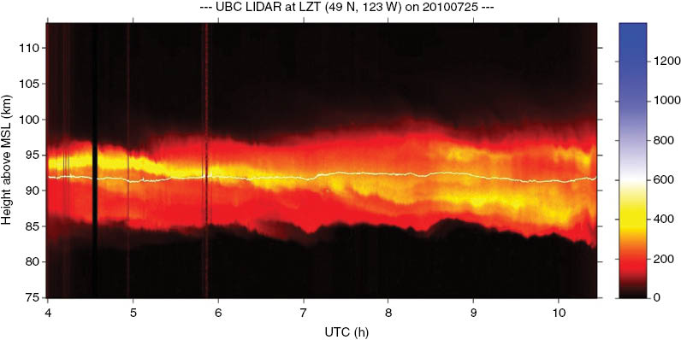
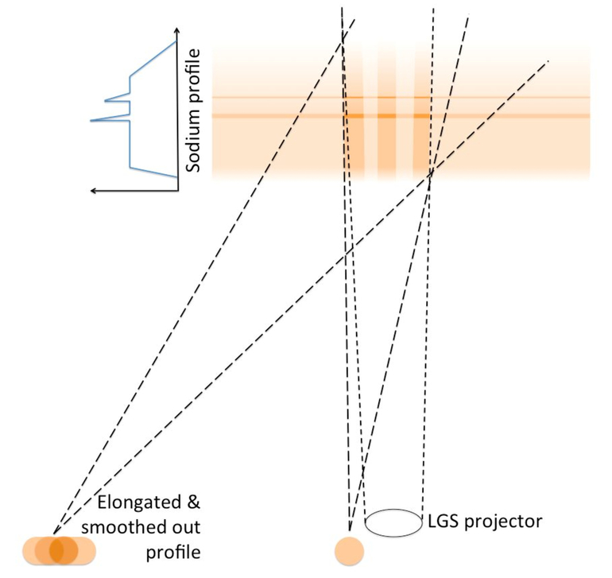
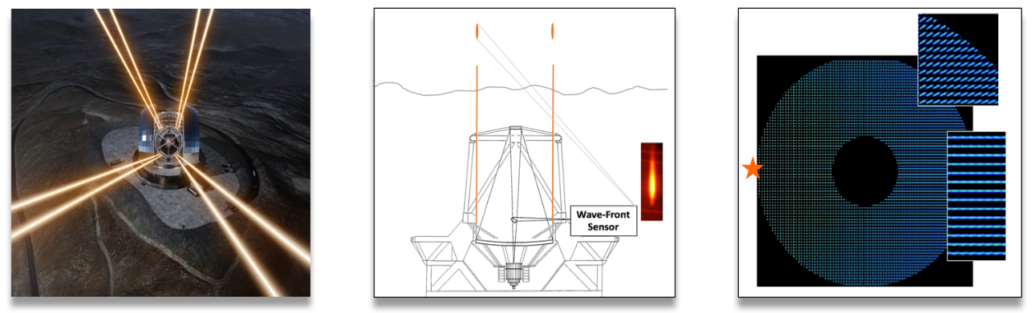
3D sodium Laser Guide Stars & ELT
Thick layer (10 – 20 km)
Evolving structues
Evolving mean altitude

Slide 3
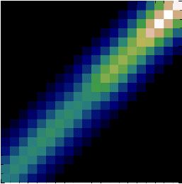
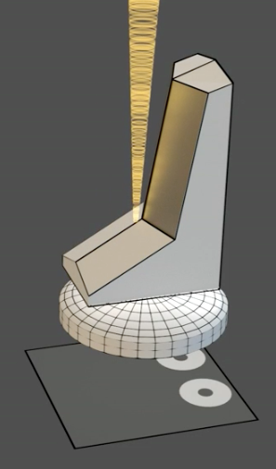
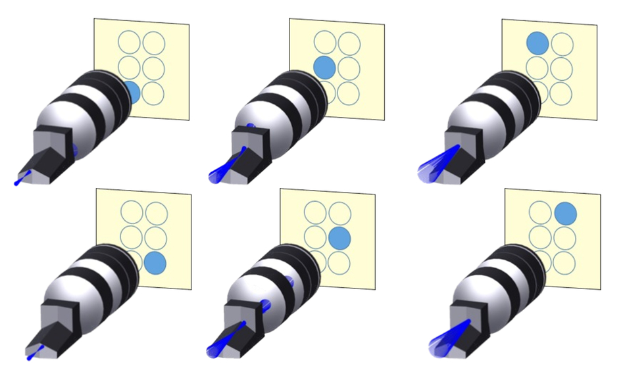
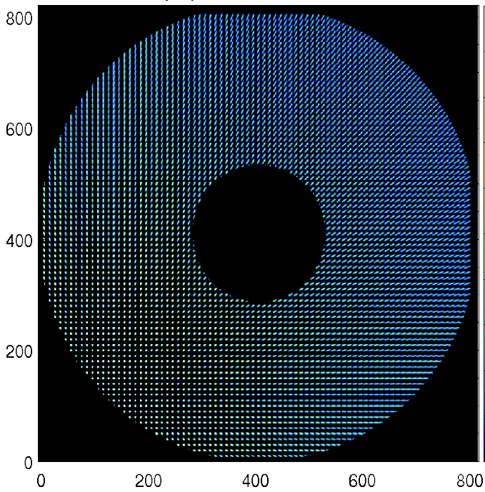
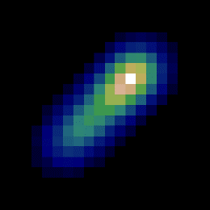
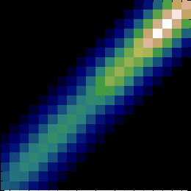
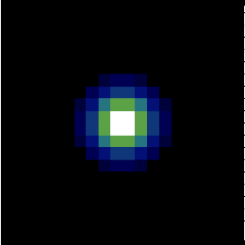
Dealing with 3D spots for Wavefront Sensing
Concepts
Shack-Hartmann
Ingot
Very promising
Yet to be fully demonstrated
=> For 2nd generation …

Slide 4
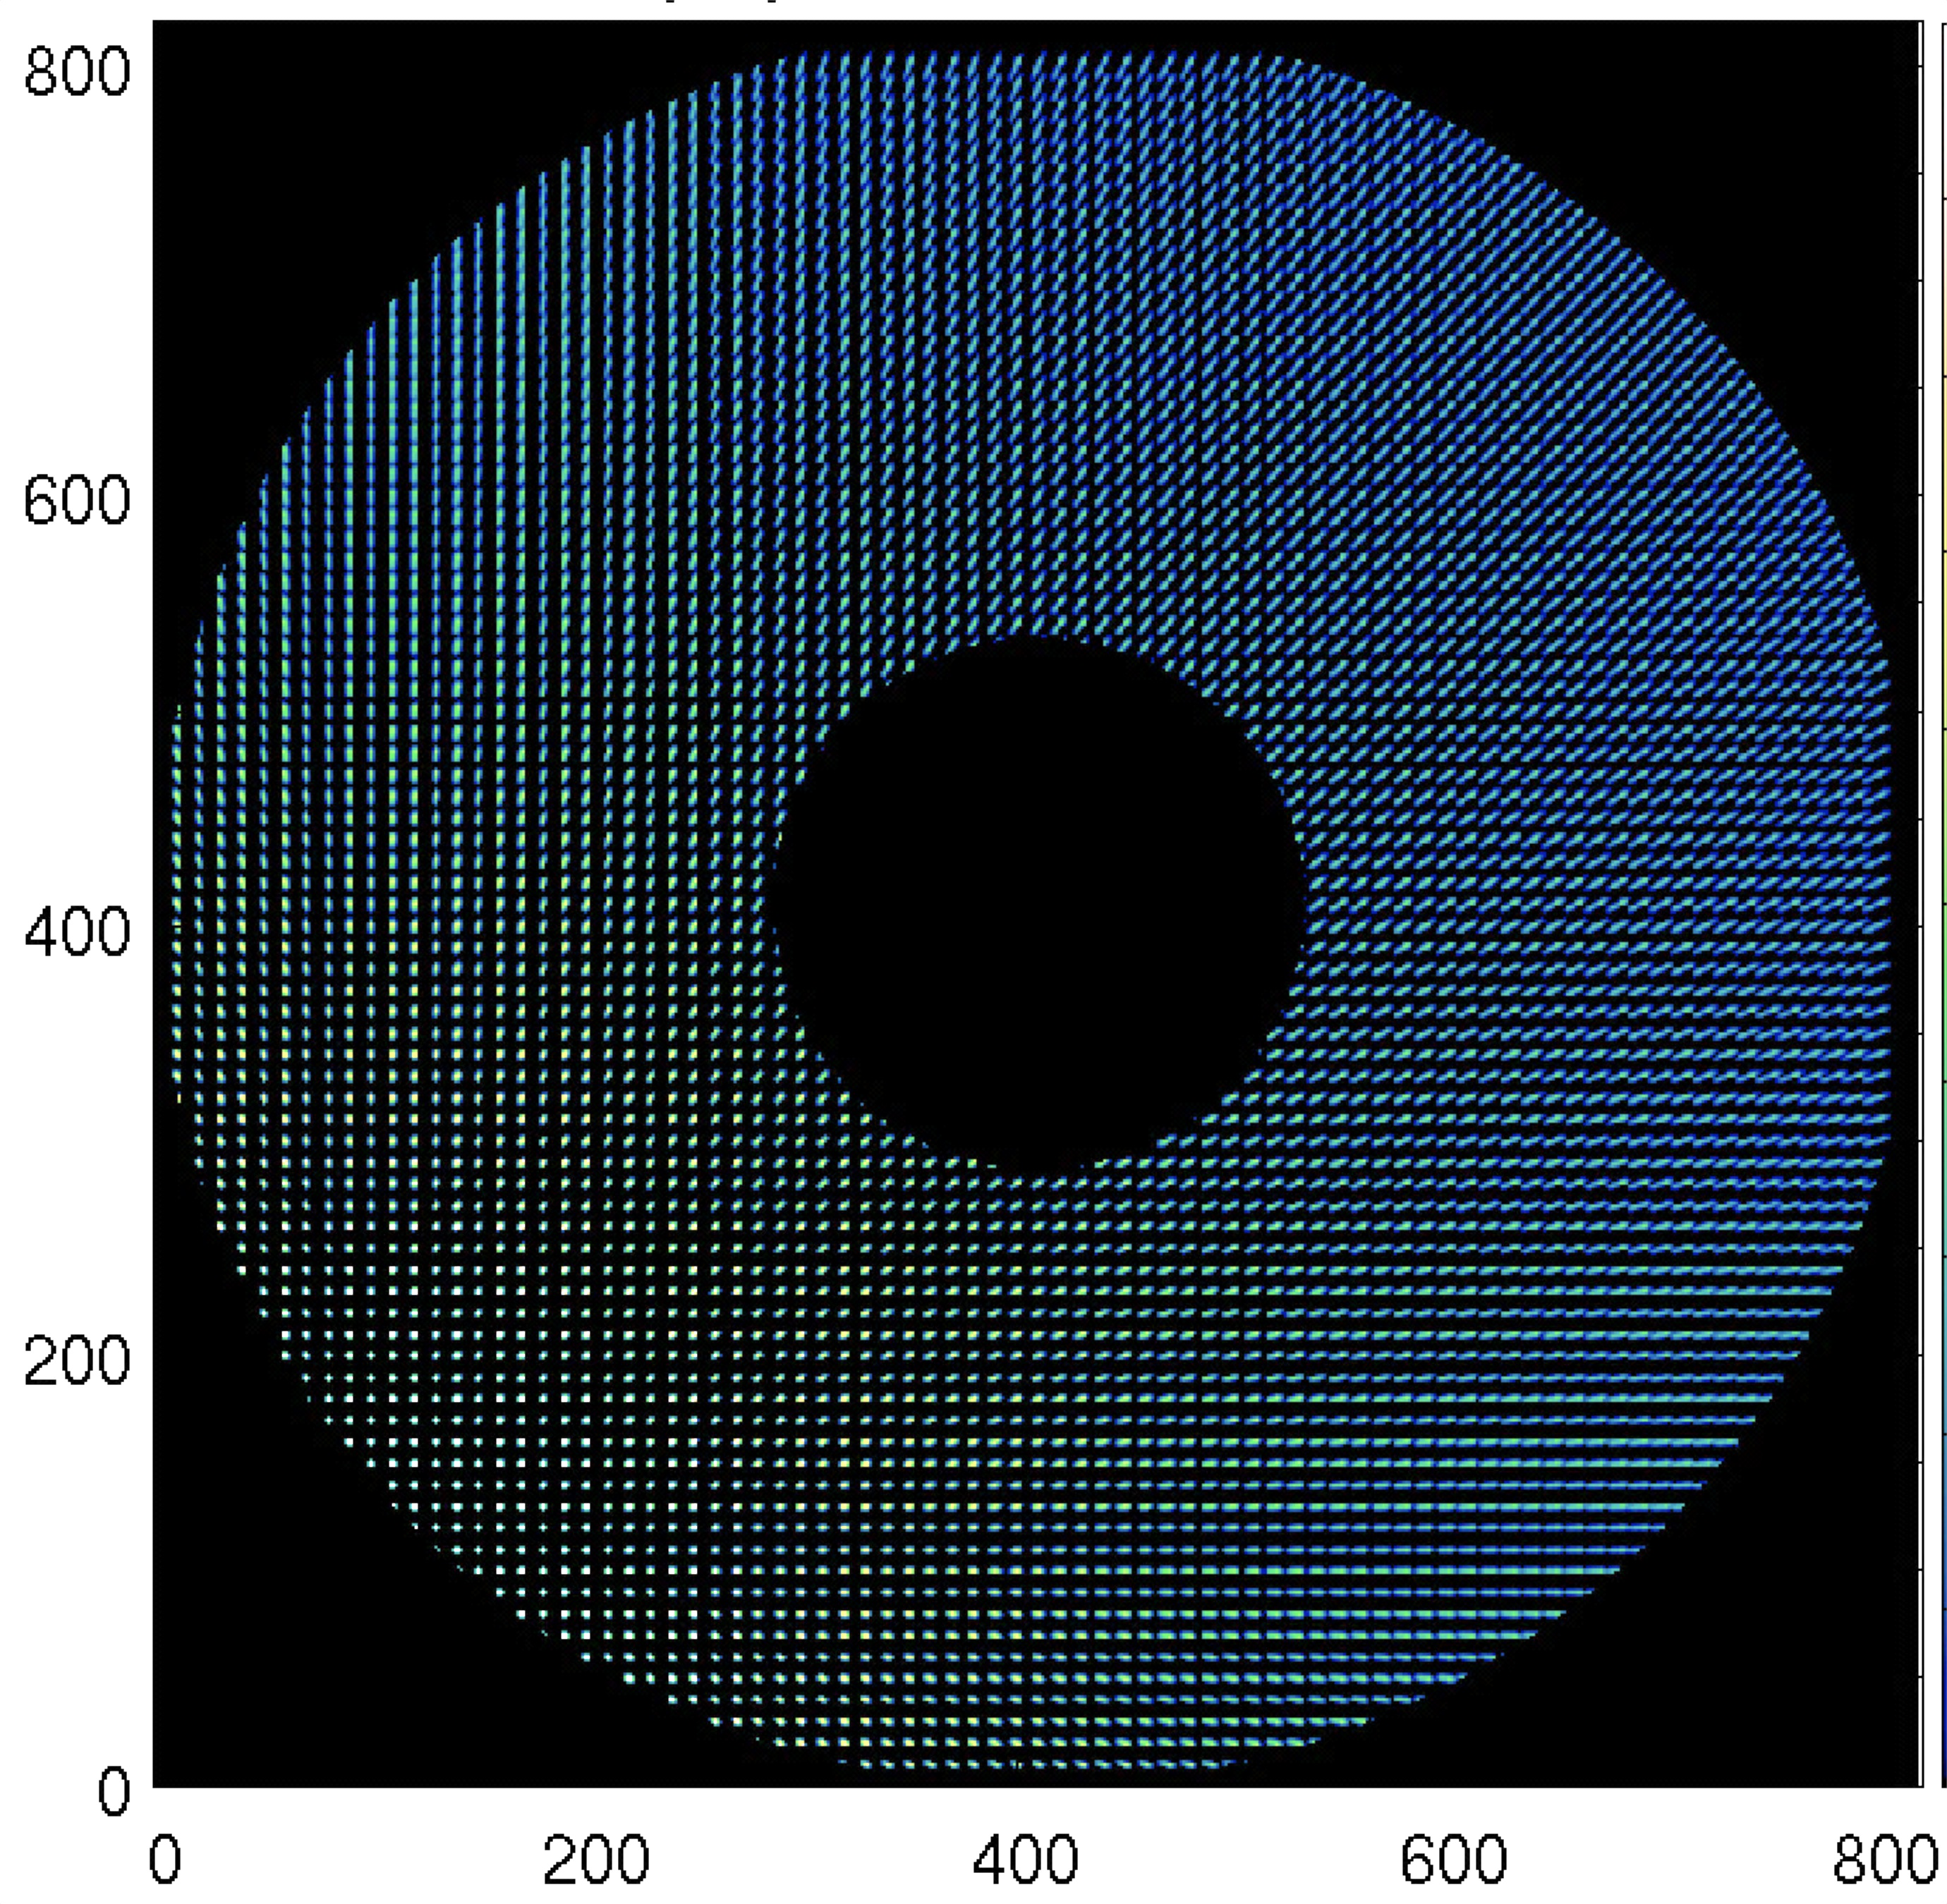
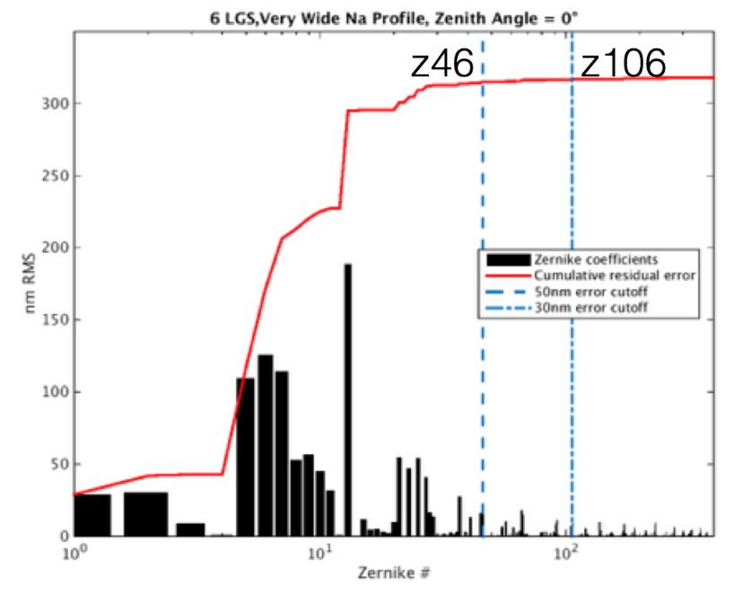
Spot elongation and truncation
Truncation induces biases that are projected on-axis by the Tomography
Up to 300nm
x6

Slide 5
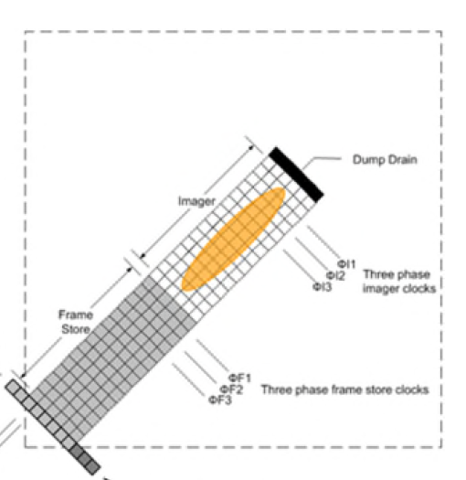
Various SH flavours … based on several detector technologies
Classical CCD
Polar CCD
« Classical » CMOS
Few hundred x few hundred pixels
Very large pixel size (>> arcsec)
Photon noise limited
Excess noise
800x800 → 1100x1100
< 3 e- RON
Tilted-µlenses
SPOOF concept
Quad Cell
Reconstruction tricks
Well adapted for central launch
Linearity / gain issues
TMT solution
ELT solution

Slide 6
Basic choice : pixel size & number
The trade-off : a reasonable sample of the spot / the FoV
  Pixel size < Spot FWHM
  Largest possible FoV > 20’’
  2 possible « extreme » solutions
  Good Laser FWHM spot (1’’) and 20x20 pixels per sub-ap
    VERY large detector => 1600x1600. Does not exist …
  Enlarge your spot => larger pixels (pix size ~ spot FWHM)
    large FoV with fewer pixels => see S Oberti Talk on Thursday
  Intermediate solution ? 800x800 or 1100x1100 pixels ?

Slide 7
Spot Packing Optimisation on Optical Frames (SPOOF)
Tilted sub-apertures
« Optimal use of each detector pixel » !!!!
F Rigaut idea
→ paper to be written ☺

Slide 8
Dealing with spot truncation
Truncation induces biases that are projected on-axis by the Tomography
Up to 300nm
x6

Slide 9
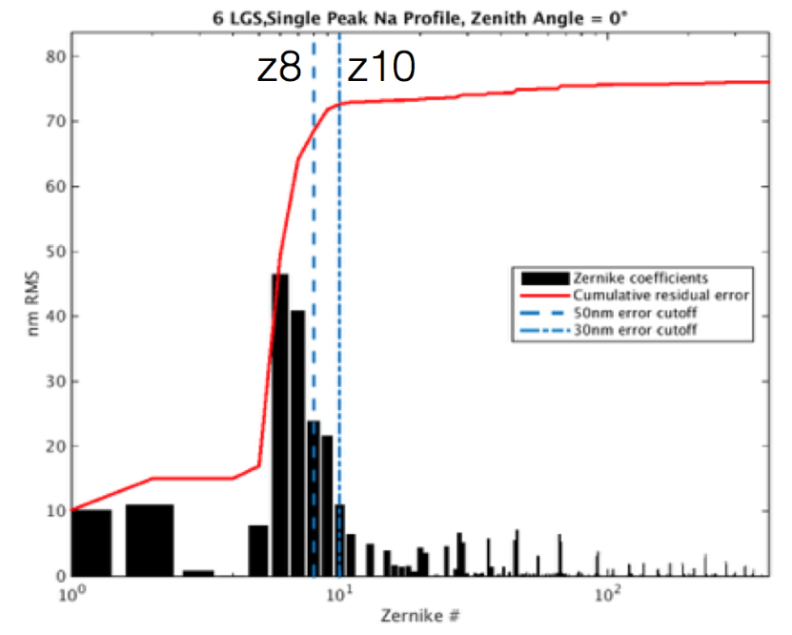
Dealing with spot truncation
One way to reduce this impact is to reject the truncated measurements
Down to 80nm
x6
Notes:
But rejecting subap, is it not bad for the atmospheric correction ?

Slide 10
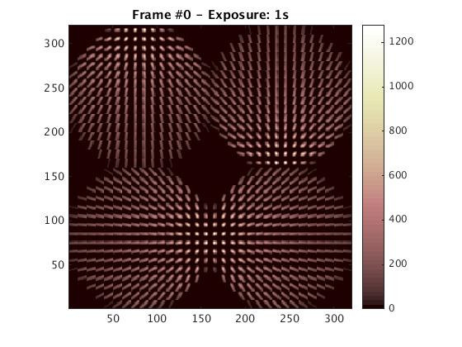
Simplification of the system : for the sake of the understanding and parameter space optimisation
8m telescope
0.5 pitch
Na altitude = 40 km (to keep the elongation geometry)
LGS asterism = « rim – ray » approach
⬄ optimal separation
10x10 pixels SH WFS
1’’ pixel
1’’ LGS spot size
Very simple « top hat » structure for the soduim density
(width : from 0 to 30 km)

Slide 11
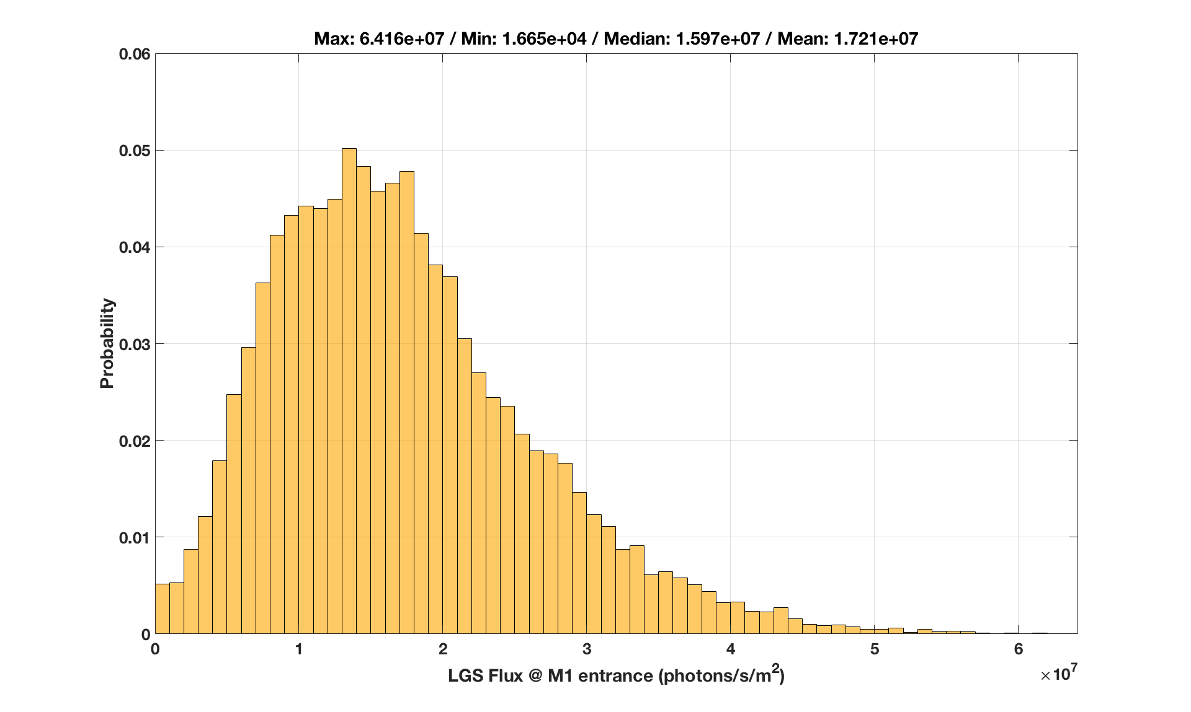
How many photons ?
From AOF (0.2m sup-ap, 1kHz) to ELT (0.5m sup-ap, 0.5kHz) => 12.5 times more photons
Mean value ~2000 ph / sup-ap / frame
Pessimistic value ~1000 ph / sup-ap / frame

Slide 12
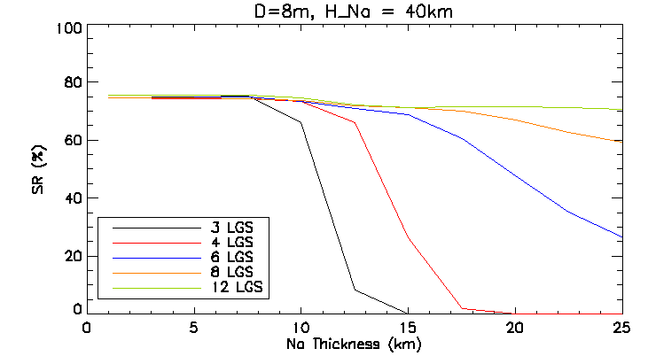
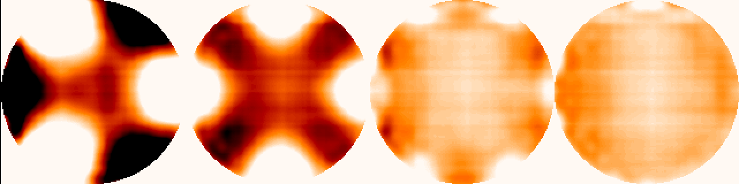
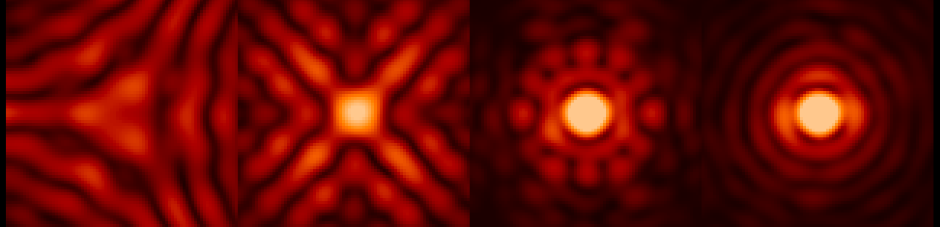
Impact of LGS number … This is critical !!!!
Average phase PSF
In that case, side launch is both a part problem and part of the solution !
Side launch => elongation x 2 w.r.t central launch
It brings measurement diversity : strong elongated measurements for one LGS are compensated by better measurements coming from the other ones

Slide 13
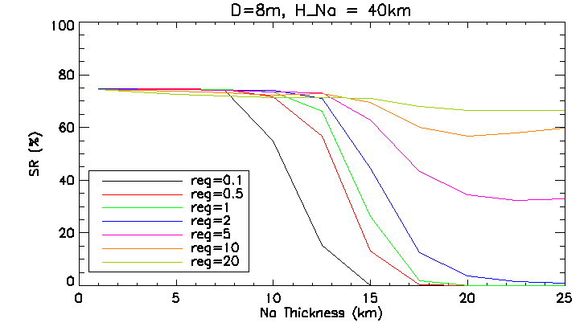
When regularisation comes into the game
Over regularisation in the elongated spot direction
To account for additional « noise » brought by trunction
ad hoc solution, could be refined with a more accurate statistical description of the truncated noise

Slide 14
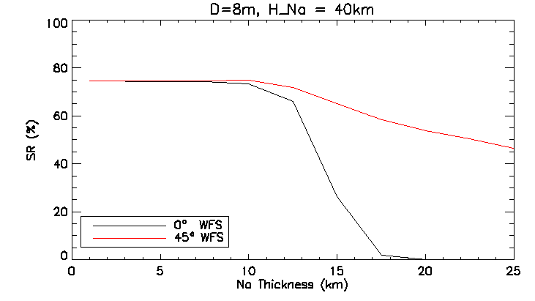
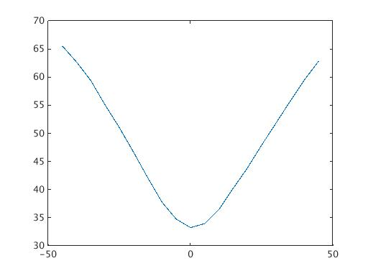
Changing the WFS orientation … 1.4 gain in effective FoV
WFS rotation angle

Slide 15
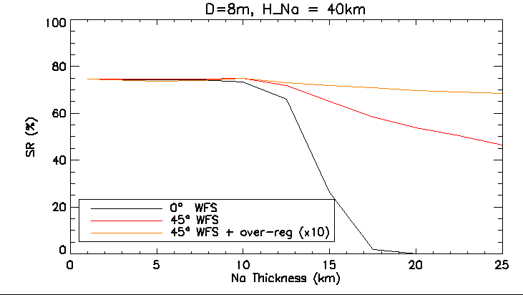
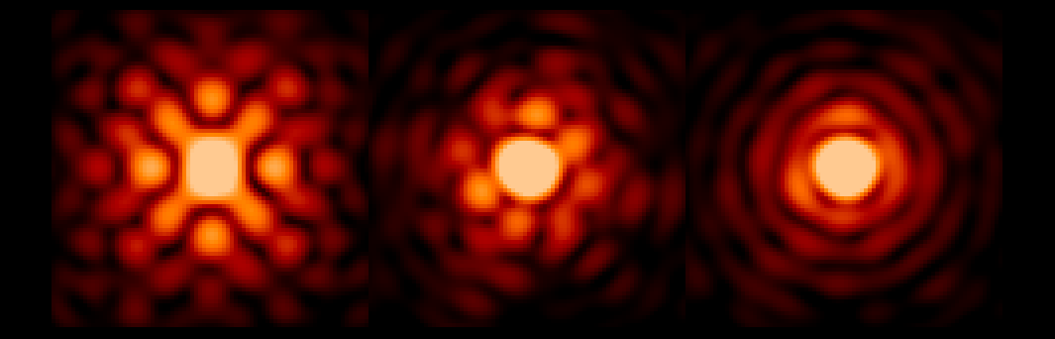
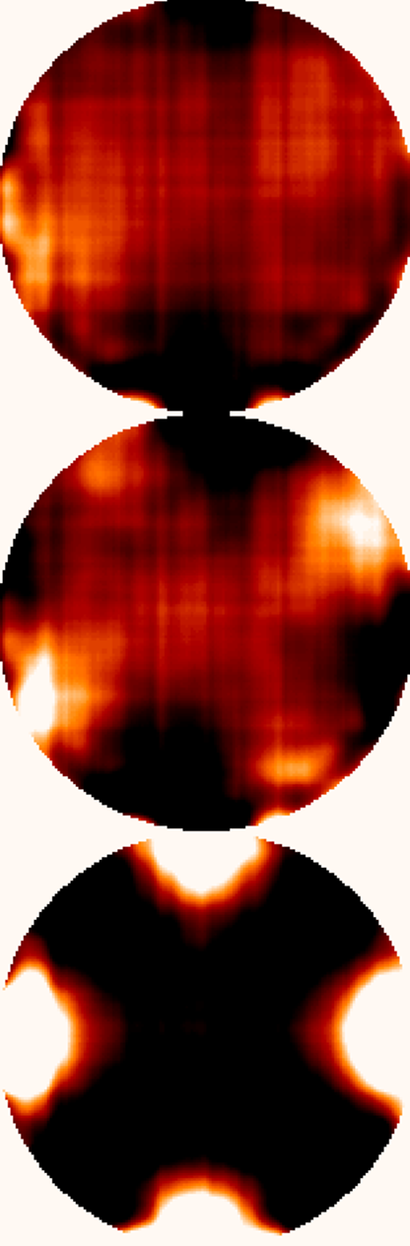
WFS orientation + over-regularisation
Average phase PSF
Rot 45° Rot 45° Rot 0°
over10

Slide 16
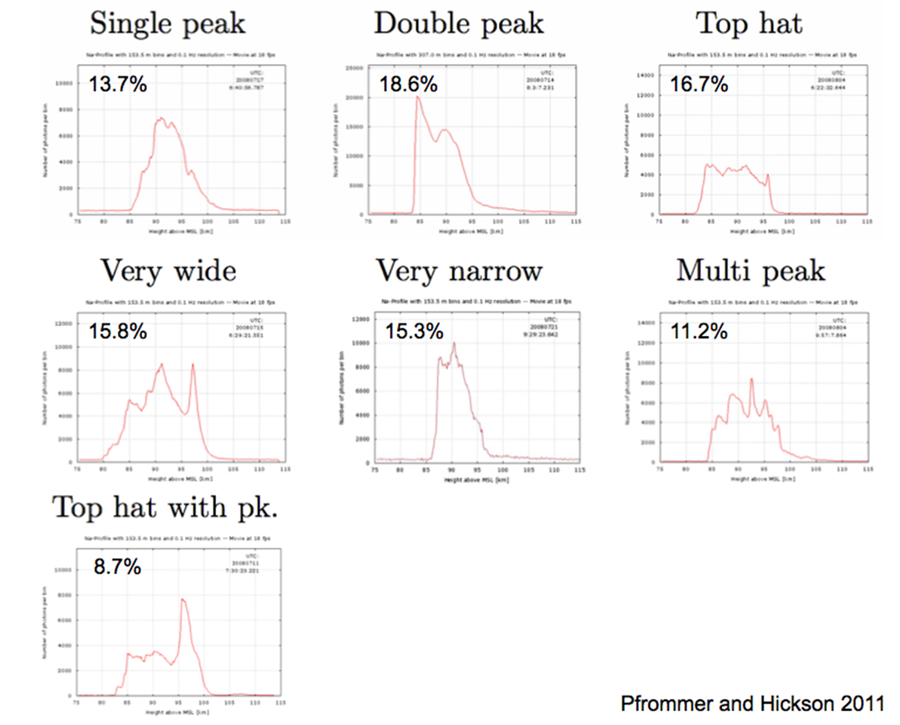
« typical » Na profiles

Slide 17
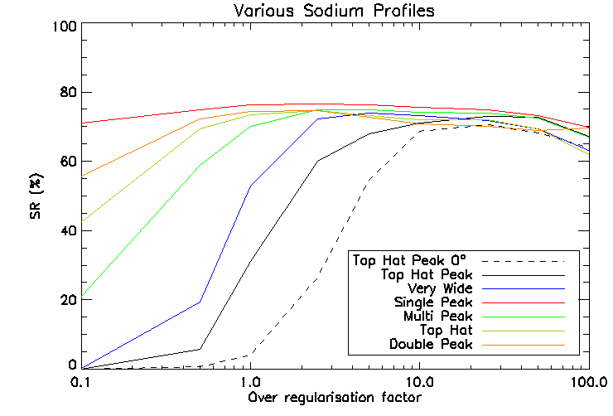
Real profiles - 4 LGS – 45° orientation – 10’’ FoV
Large dependancy on Na profile
Large dependancy on Na profiel
72.5 ± 2.5 %
55 ± 20 %

Slide 18
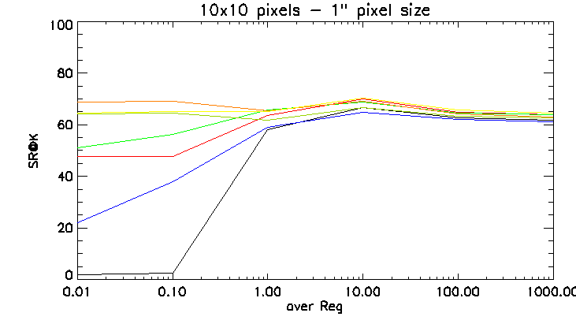
And now … on « real » HARMONI simulations
ELT size
9 Layers turbulence (mean ESO profile)
6 LGS
1000 ph
Ron = 3e-
classical threshold CoG
7 Soduim profiles
Adjustement of the over-regul
10x10 pixels per sub-ap (most pessimist case)
Pixel size = 1’’ (most severe case)
10x10 pixels | 10x10pixels - « opt reg » | 14x14 pixels | No elongation
62 ± 5 % | 68 ± 2 % | 70 ± 1 % | 71%

Slide 19
Toward a baseline for ELT LGS assisted instrument
14x14 pixels per sub-ap => 1100x1100 pixels (CMORE camera)
Pixel size ~ 1.25’’ (extensive simulations still on going for fine tuning)
WFS optimal orientation for each LGS => effective FoV ~ 25’’
No fancy µlenses design (although it is still a possible back up sol)
No fancy centroiding method (although it is still a possible back up sol)
Adapted reconstructor regularisation to deal with residual truncation (if any)
Should ensure a bias free signal and an quite efficient tomographic reconstruction !
Several back up solutions that can be easily implemented or use in case of unexpected phenomena

Slide 20
Conclusions
Spot elongation is a problem for ELT but :
Many solutions exists (hardware and software) and can be combined to mitigate this problem
The graal : to have as much pixels as possible for ensuring
  the best possible measurements in the non-elongated spot direction (« small pixels »)
  the largest possible FoV in order to minimise truncation effects
Playing with the reconstruction process help to deal with residual spurious measurements due to truncation
  => increase the robustness of any hardware solution
On going demonstration at LAM of a full scale prototype of one LGS WFS for HARMONI
Joint effort between HARMONI and MAORY teams to tackle this issue and to converge toward a common baseline : very good example of fruitfull collaboration between ELT instrument teams !!!!

Slide 21


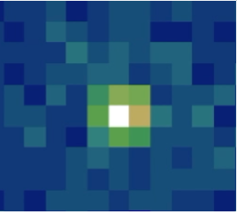
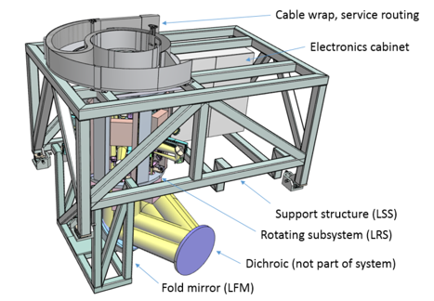
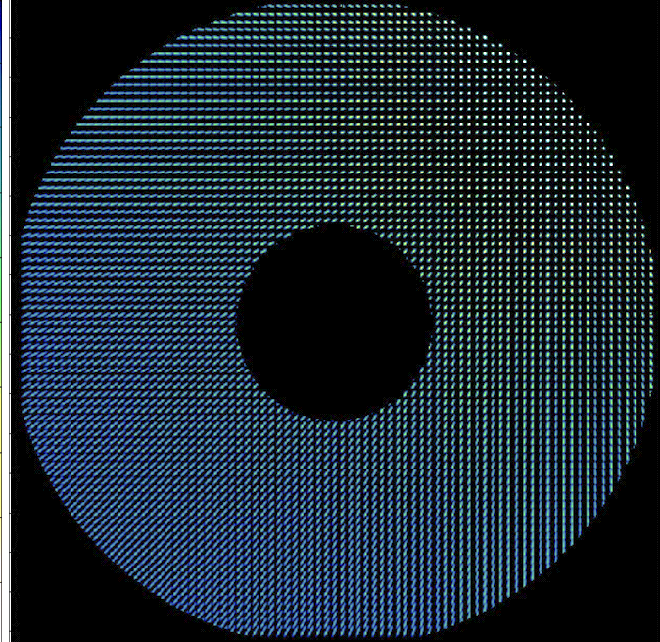
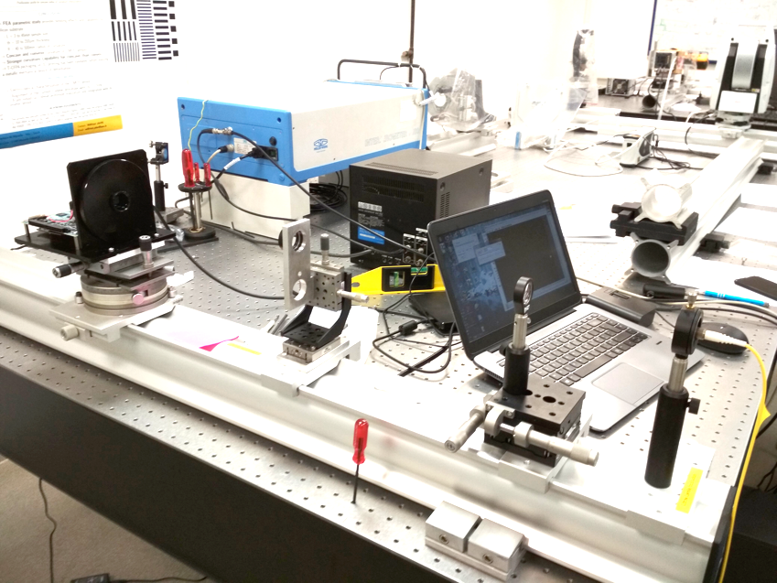
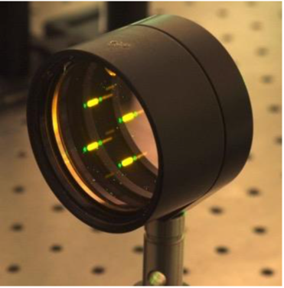
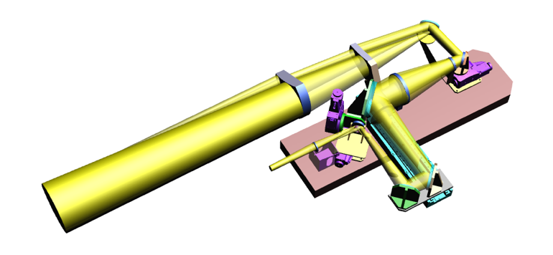
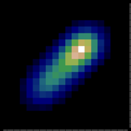
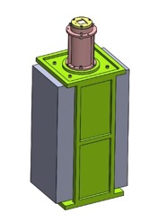
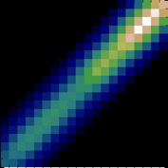
HARMONI Overview
Laser Guide Star WFS = 80x80 Shack-Hartman
2 years post-doc at LAM for validation of the LGSWFS strategy for HARMONI !!
x6

Slide 22
WFS workshop (4th edition)
Firenze : 28-30 October 2019
Talk to Enrico Pinna for more info
L Blanco,

